Slide 1
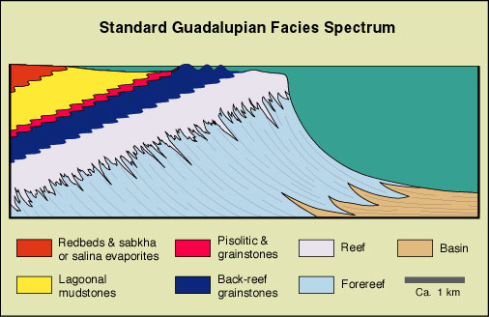
Notes:
Let’s look at the standard Guadalupian Facies Spectrum starting with the Basin facies where the calm, deep water …

Slide 2
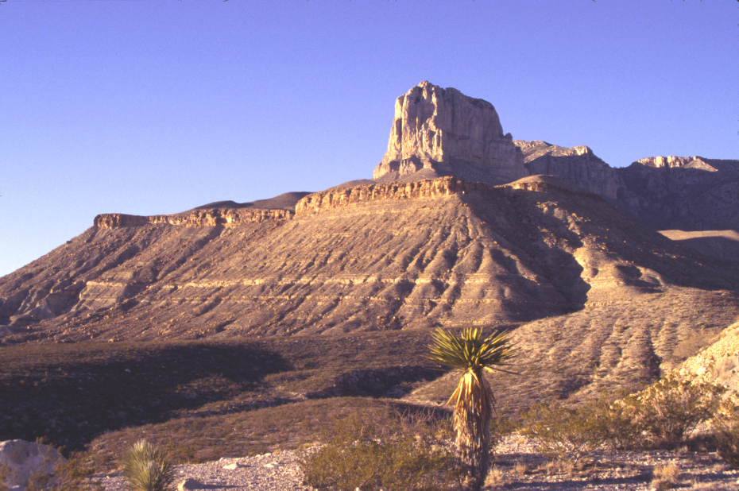
Basin facies
Notes:
… led to the formation of thin, highly continuous layering.

Slide 3
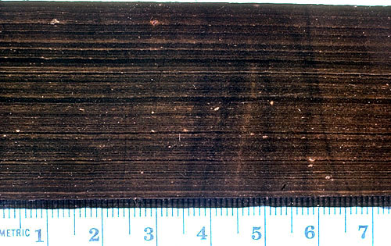
Laminated, organic-rich limestone
Notes:
A close-up view of this unit shows millimeter-scale laminations and extremely dark colors from abundant organic matter. Both characteristics are typical of deep, stagnant basins where oxygen depletion inhibits the decomposition of organic material.

Slide 4
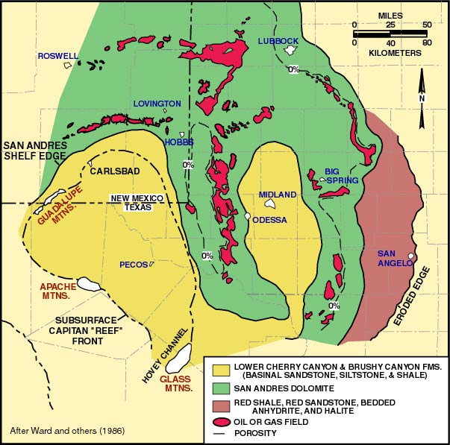
Notes:
Upon burial and heating the organic material is converted into oil which eventually migrates into more porous materials. Oil reservoirs are relatively common in the area, which, as we will see in the next lesson, will play an important role in the formation of Carlsbad Caverns.

Slide 5
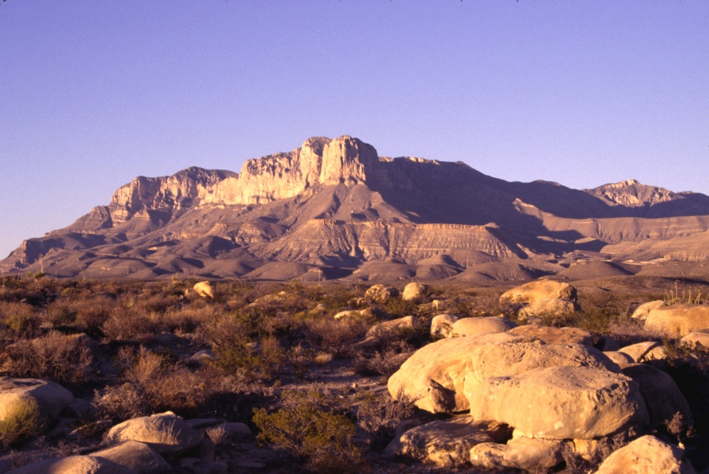
Sand lenses exposed in basin facies
Notes:
Within the basin facies there are numerous sand lenses that are more resistant to erosion than the laminated basin limestone.

Slide 6
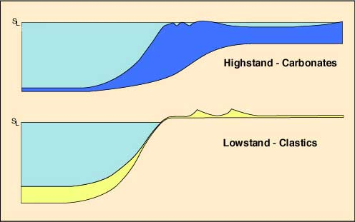
dunes
Turbidity current
Notes:
These were formed during periods of lower sea level when wind-blown sand was brought to the reef front where it was transported down the reef slope via sand slides and turbidity currents. Turbidity currents are mixtures of sediment and water that tumble down slope somewhat like underwater avalanches.

Slide 7
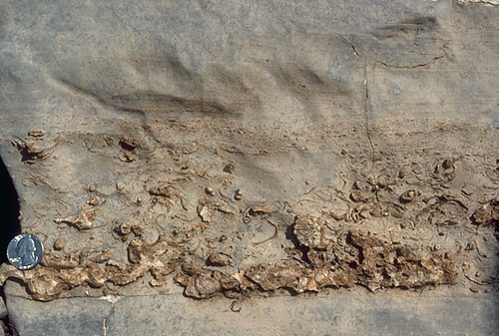
Graded turbidite
Notes:
Because turbidity currents contain a variety of particle sizes and larger particles settle more quickly than finer ones, the deposits of turbidity currents, or “turbidites” , typically show graded bedding with finer particles above coarser. This one was deposited at the base of the reef slope and includes numerous shell fragments.

Slide 8
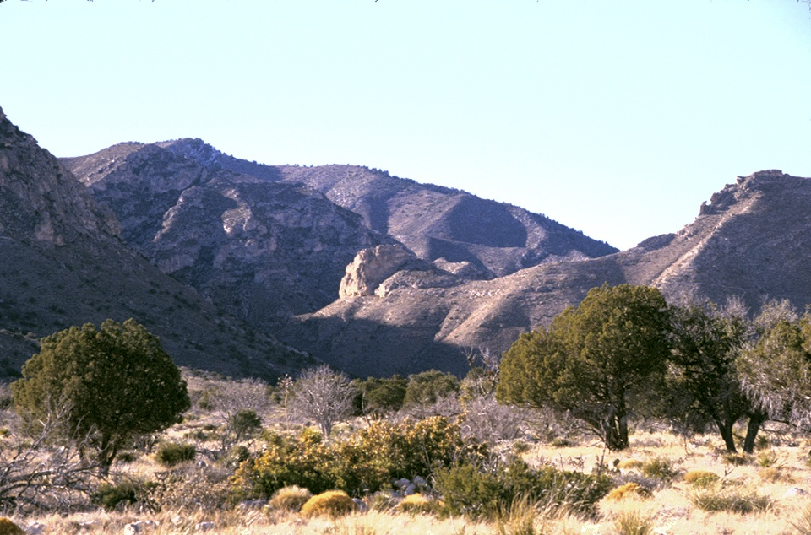
Pine Spring Canyon
Notes:
The basin facies can be seen at the mouth of Pine Spring Canyon just west of the Visitor Center and …

Slide 9
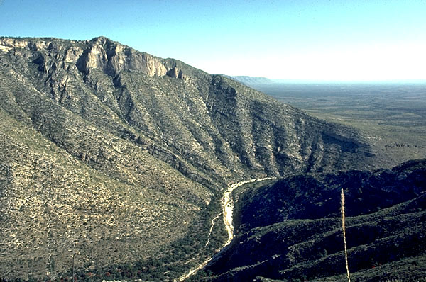
Geology Trail
McKittrick Canyon
Notes:
… a few miles north at the mouth of McKittrick Canyon. The hike up McKittrick Canyon is rated “best in Texas” and although that may not mean much, the “Geology Trail”, which you can just make out on the north wall of the canyon, offers a world-class tour through the ancient reef.

Slide 10
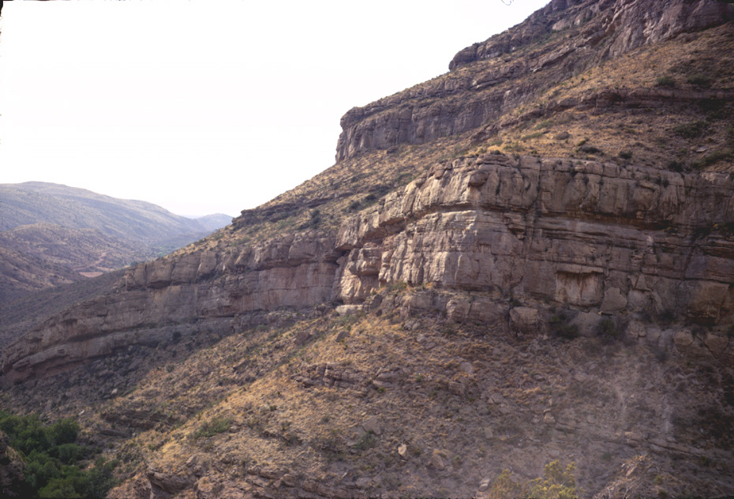
Basin sandstone
fine
coarse
Notes:
At the mouth of McKittrick Canyon you can see the graded sandstone so characteristic of turbidite deposition.

Slide 11
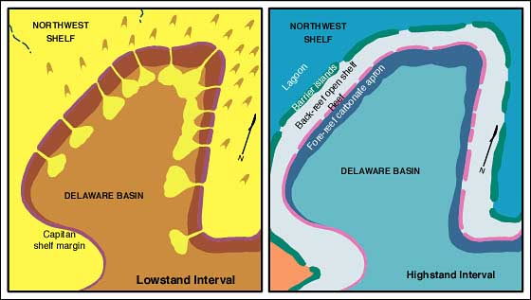
Submarine canyon
Notes:
On the steep reef slope turbidity currents flowed fast enough to erode submarine canyons into the carbonates that were deposited during intervals of higher sea level. During low sea level intervals virtually all sedimentation occurred in the basin.

Slide 12
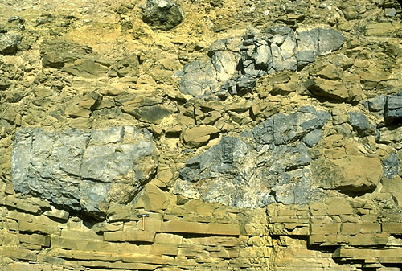
carbonate slope material
hammer
sandstone
Notes:
Occasionally large blocks of carbonate slope material were carried into the basin via debris flows. Note the rock hammer for scale.

Slide 13
Notes:
Moving from the basin to the forereef facies, note that, although exaggerated in this diagram, the forereef has by far the steepest slopes of all reef environments. Periodically blocks of the reef will break off and tumble onto the forereef.

Slide 14
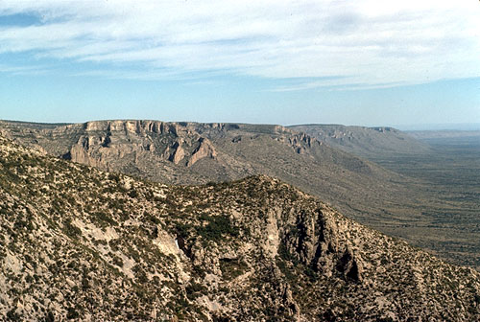
Cement filled vertical fractures
Notes:
Looking north from McKittrick Canyon along the Capitan reef escarpment you can see the cemented fractures that formed parallel the reef escarpment as gravity pulled it towards the forereef. These formed at the same time sedimentation was occurring.

Slide 15
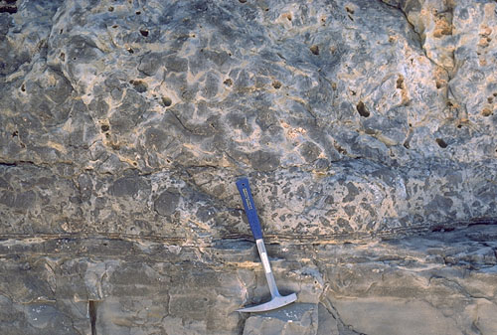
Forereef carbonate debris flow
Notes:
The forereef is dominated by carbonate debris flows derived from unstable, fragmented reef material.

Slide 16
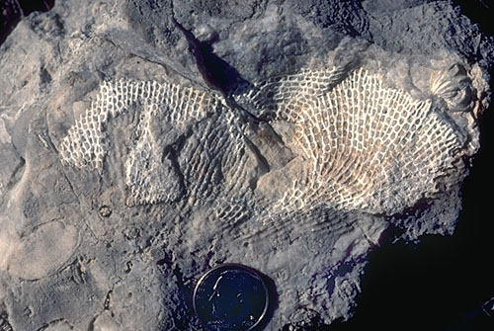
Fenestrate bryozoan. Forereef slope dweller.
Notes:
Such debris flows would have periodically buried Capitain fore-reef inhabitants, like this fenestrate bryozoan. This sample is from the Geology trail on north wall of McKittrick Canyon.

Slide 17
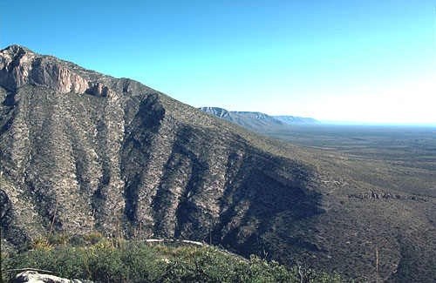
Steeply dipping forereef facies
Notes:
Forereef strata were deposited parallel to the surface of the reef slope. Thus the modern slope here must pretty much coincide with that of the ancient reef slope.

Slide 18
Notes:
Now let’s look at the heart of the matter – the reef facies itself.

Slide 19
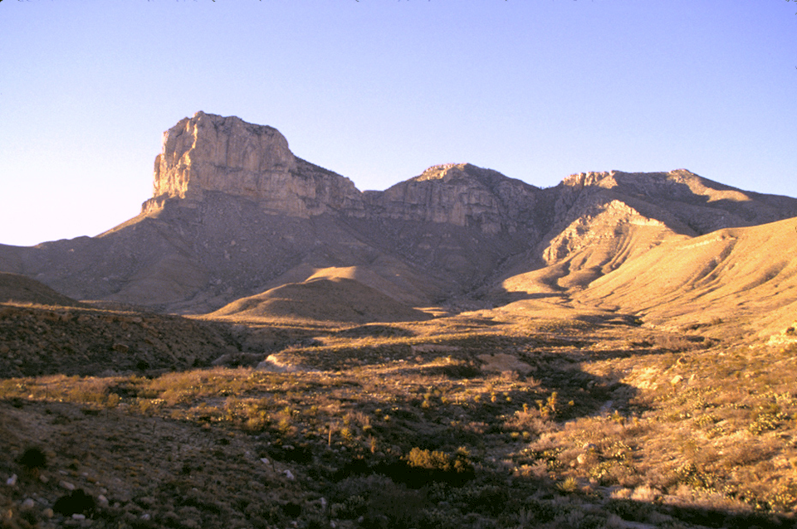
Massive El Capitan Limestone - reef facies
Notes:
El Capitan shows clearly the massive character of the reef facies limestone. In geology the term massive means without structure or layering.

Slide 20
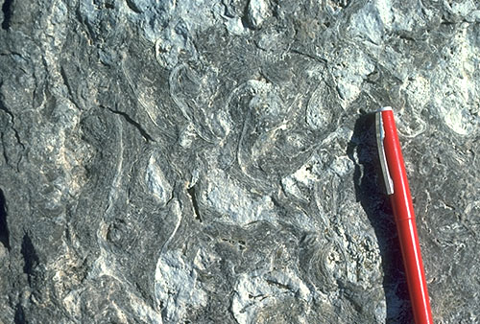
Calcareous Algae (Tubiphytes)
Notes:
The most common reef building organism here was not coral, but extinct forms of calcareous algae known as Tubiphytes.

Slide 21
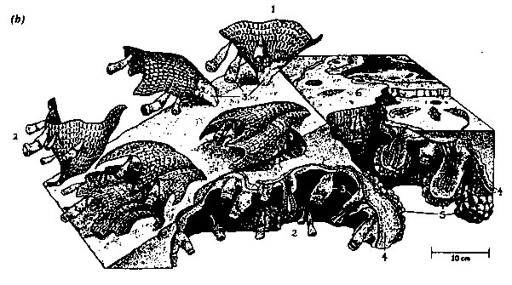
Bryozoan
Tubiphyte
Notes:
Tubiphytes lived on and alongside lace-like bryozoans,

Slide 22
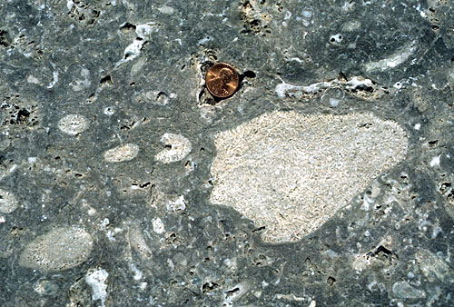
Calcareous Sponges
Notes:
… calcareous sponges, …

Slide 23
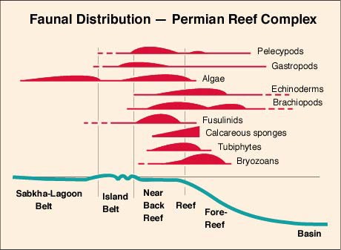
Notes:
… and many other organisms - with the notable exception of coral.

Slide 24
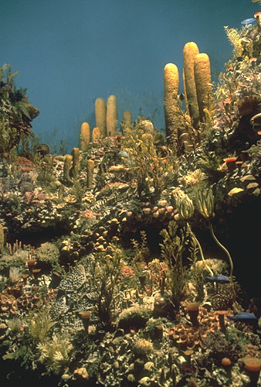
Notes:
This diorama of the Capitan reef displayed at the Permian Basin Petroleum Museum in Midland, Texas emphasizes the tall framework sponges and the abundant encrusting fauna.

Slide 25
Notes:
Wave action was most intense on the reef, but as we move towards the back-reef the water becomes calmer.

Slide 26
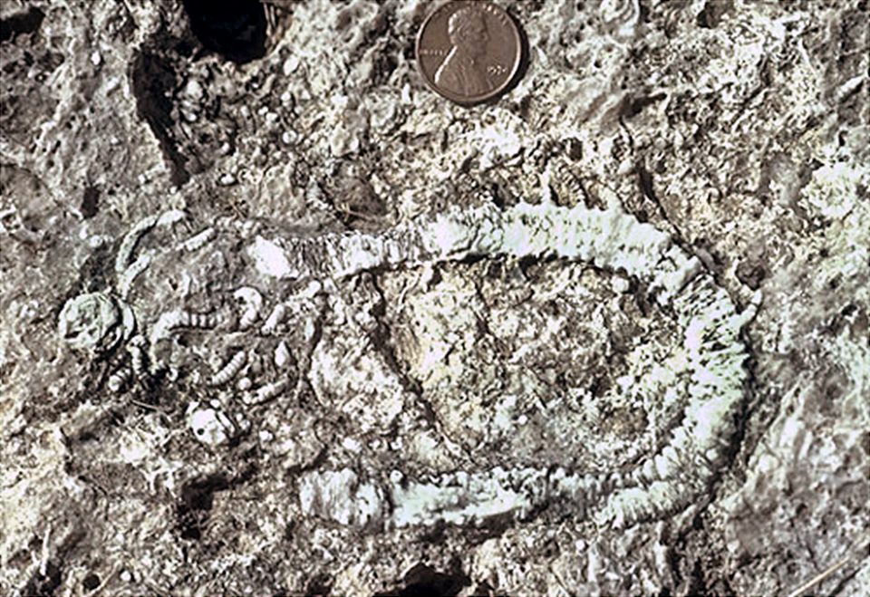
Crinoid fossil
Notes:
The fact that this fossil crinoid, an ancient relative of the starfish, is virtually intact indicates that at least local pockets of low energy and/or high rates of marine cementation of sediment existed in the near back-reef.

Slide 27
Notes:
As we move into the back-reef notice that some of it is exposed above sea level as small barrier islands.

Slide 28
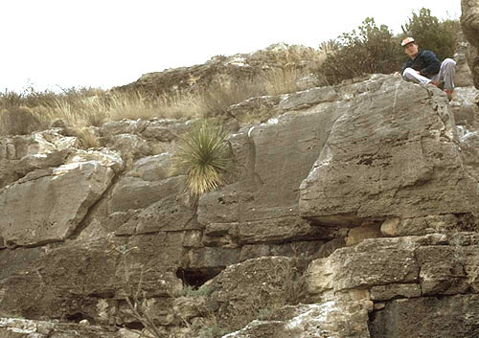
Cross bedded grainstones = beach origin
Notes:
These islands consisted essentially sand made of broken-up shell material. Here the carbonate sand has seaward-dipping cross-beds that are probably of beach origin.

Slide 29
CO₂
Notes:
Carbon dioxide is driven out of solution by warm lagoon temperatures, thereby lowering the concentration of carbonic acid which holds carbonate in solution. Conditions in the lagoon therefore promote the inorganic precipitation of carbonate.

Slide 30
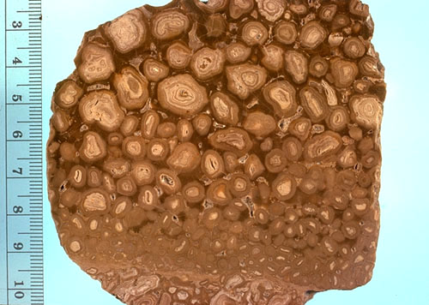
Pisolitic dolomite
Notes:
Inorganic carbonate precipitation coats grains rolled about by wave action producing pisolites in the near back-reef where some wave action is felt.

Slide 31
Notes:
In the extremely clam water of the lagoon facies …

Slide 32
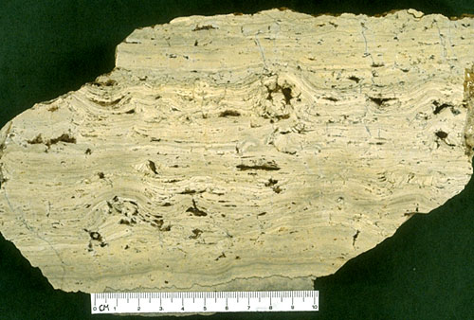
Lagoonal facies – stromatolites and evaporites
Notes:
… fine carbonate mud deposits along with carbonate secreted by algal mats known as stromatolites. Some of the larger voids here are the result of evaporite mineral dissolution.

Slide 33
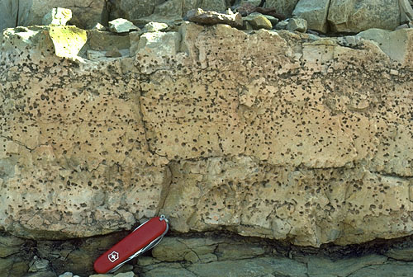
Dolomite with evaporite crystal molds
Notes:
The proximity to land and high salinity of the lagoon favors the precipitation of Mg carbonate over Ca carbonate, so dolomite is the dominant carbonate here. Note the abundant voids left by the dissolution of evaporites.

Slide 34
Notes:
Finally, in near-shore tidal flats evaporites deposit with rain-water oxidized clastic sediments, known as redbeds.

Slide 35
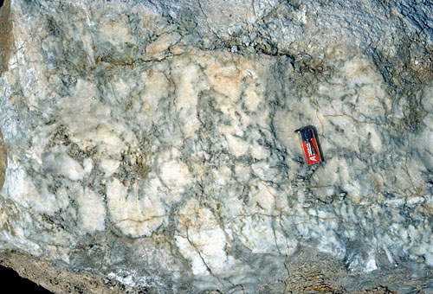
Massive nodular gypsum
Notes:
The dominant evaporite here is massive nodular gypsum.

Slide 36
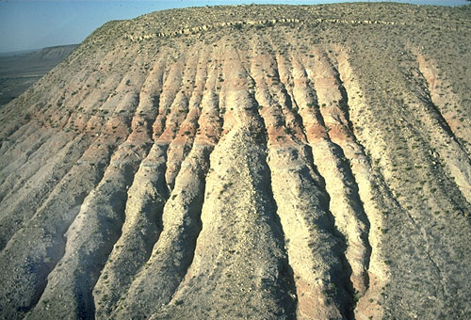
dolomite
Redbed (siltstone)
evaporite (gypsum)
Notes:
Red beds and evaporites become interbedded as shorelines shift with climate and sea level changes. Note the gully-formation in the soluble evaporite and presence of a capping layer of dolomite which has preserved this outcrop from complete erosion.

Slide 37
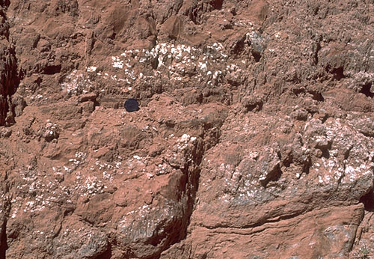
Red siltstone and nodular gypsum
Notes:
Red siltstone and nodular gypsum are indicative of the back-reef facies, but …

Slide 38
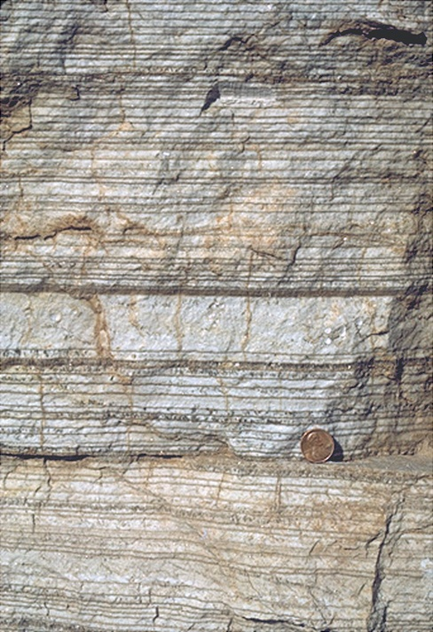
Laminated evaporite (basin facies - Castile Formation.)
Notes:
… laminated evaporite is indicative of the basin facies during the time when the basin became restricted from the open ocean. Dark laminae are calcite plus organic matter; light laminae are gypsum. Laminae are considered to be annual layers reflecting variations between summer (evaporitic) and winter (less evaporitic) conditions.

Slide 39
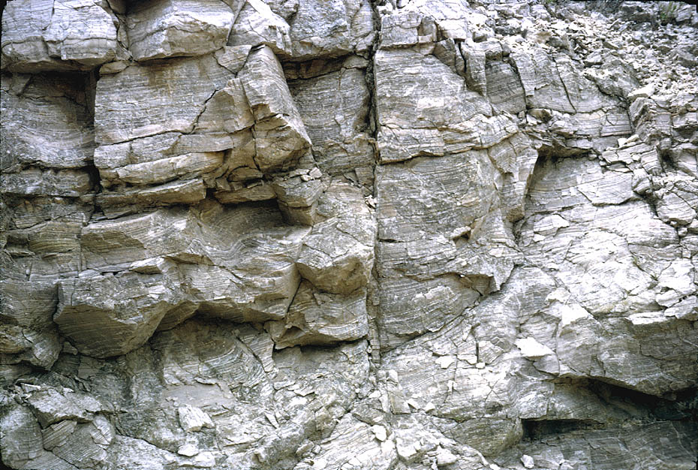
Laminated evaporite (basin facies - Castile Formation.)
Notes:
The laminated evaporites are represented by the Castile Formation whose thickness of up to 600m, …

Slide 40
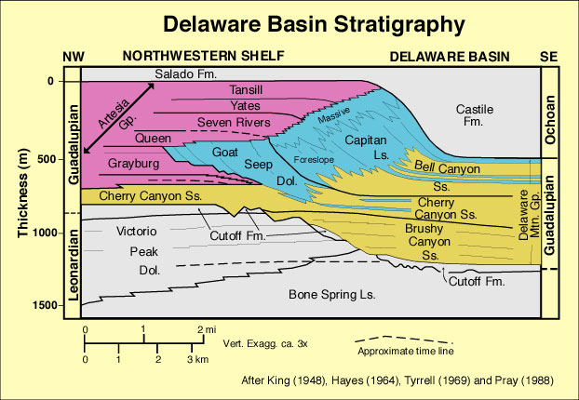
Castile Fm. Evaporite buries reef.
Notes:
… is enough to completely bury the reef.

Slide 41
Castile Formation
Notes:
Due to its high solubility the Castile Formation has been almost completely eroded from the basin leaving the relatively resistant reef intact.

Slide 42
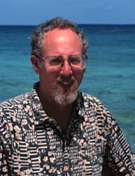
A big nod goes to:
Dr. Peter A. Scholle
Director and State Geologist
New Mexico Bureau of Mines & Mineral Resources New Mexico Tech
http://geoinfo.nmt.edu/staff/scholle/guadalupe.html#genset
Notes:
I would like to acknowledge the resources and support of Dr. Peter Scholle, which contributed enormously to this lesson. Thanks Peter!

Slide 43
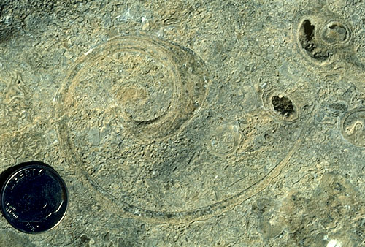
Shelf-ward edge of Capitan reef
Notes:
Shelf ward edge of Capitan reef. Coatedgrains, green algae, fusulinids, molluscan fragments and other grains are present. Note also the large belerophont gastropods which were common sediment grazers in this environment.

Slide 44
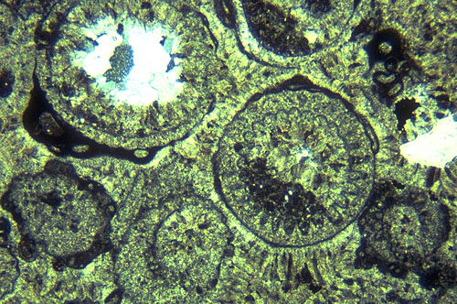
Enlargement of green algae grains
Notes:
The predominant grains are Mizzia green algae (some heavily encrusted by foraminifers
and blue-green algae).

Slide 45
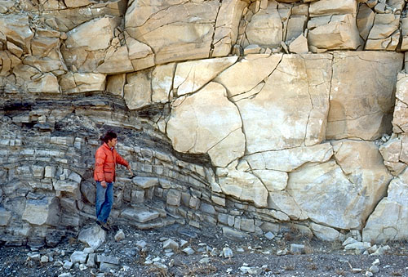
Sandstone fill of submarine fan channel
Notes:
Margin of Brushy Canyon Formation submarine fan channel incised into "overbank" sediments.
Sandstone fill of channel shows amalgamation of several flow units as well as flowage and
injection of sand into the surrounding strata of the channel walls

Slide 46
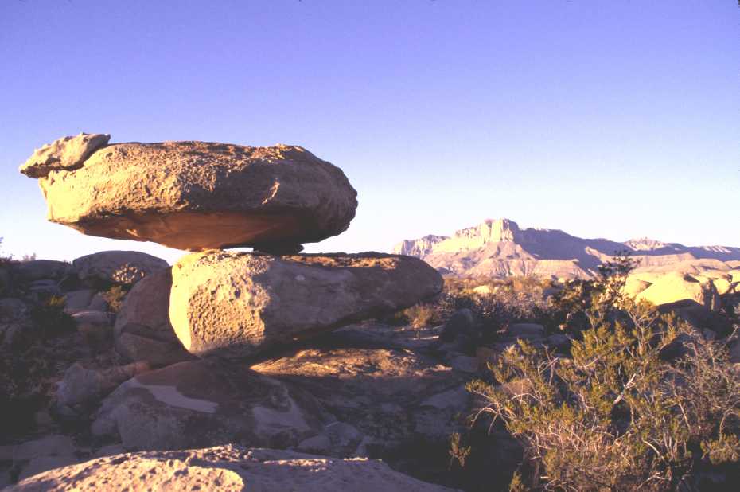
Lowered base level exposes reef
Notes:
Guadalupe 09 DBH El Capitan from the south

Slide 47
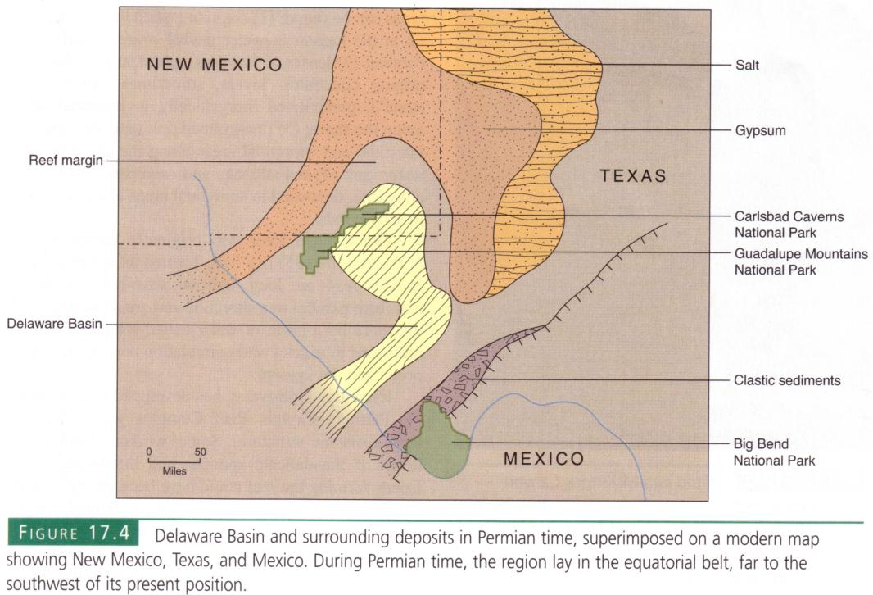

Slide 48
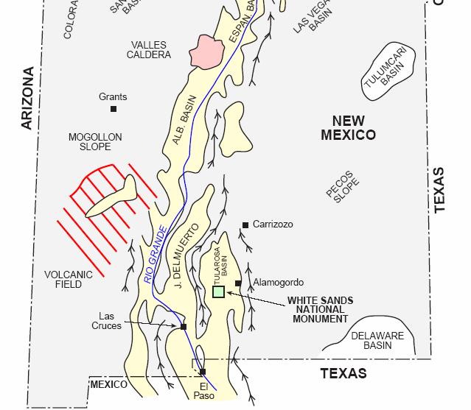
Notes:
The reason the reef is exposed is due to the Rio Grande rift

Slide 49
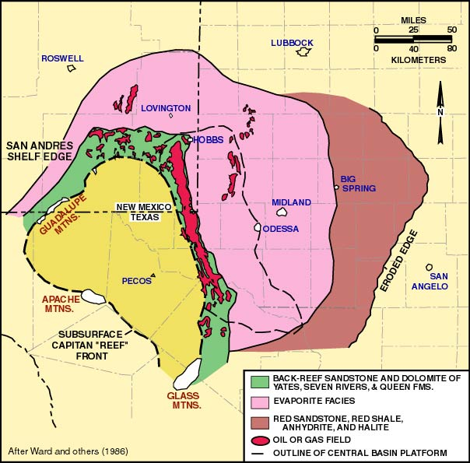

Slide 50
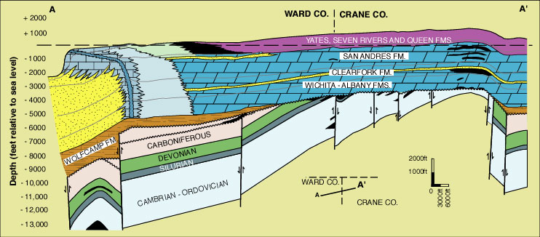
Notes:
Cross section through the western part of Central Basin platform showing relationship between structure and stratigraphy
of Paleozoic strata. Oil fields are shown in black. Modified from Ward and others (1986).

Slide 51
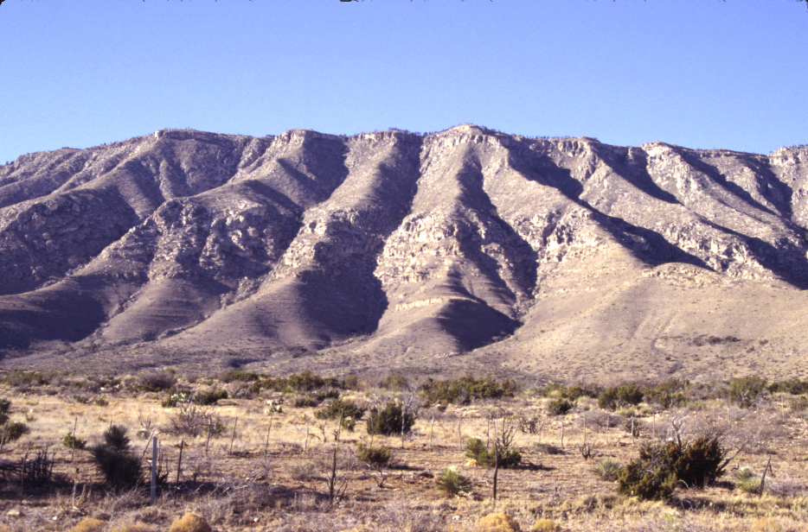
Notes:
Guadalupe 02 DBH North of McKittrick Canyon

